Slide 1
Will ΜΑΜΟΤΗ survive in the Modern Age?
from Mosquito Plethora to Human Health and Quality of Life
Internal Beyond Presentation 05/09/2022
Argyro Tsantalidou Theoktisti Makridou
Lazaros Stamogiorgos
Dimitris Sainidis
Kwstis Tsaprailis
George Arvanitakis

Slide 2
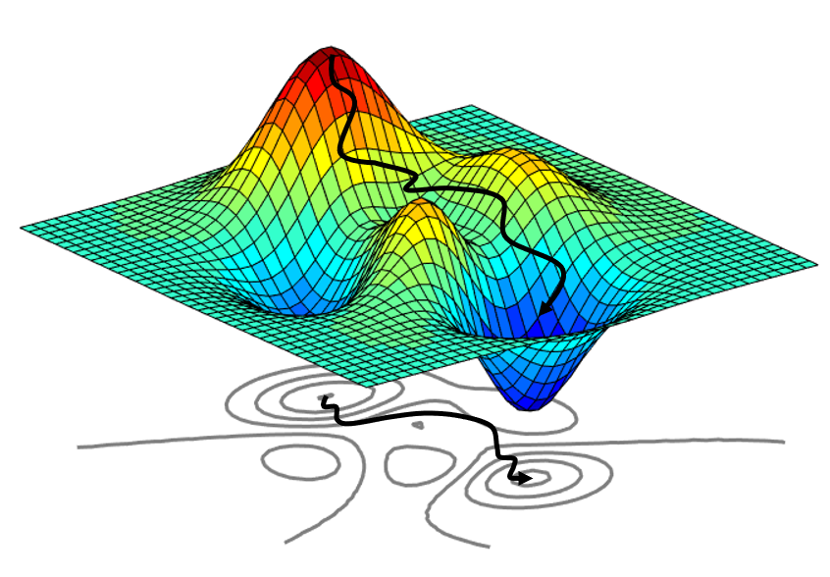
Few words about the Team
Electrical Eng.
Computer Science
Radio Engineering
Data Science
Optimisation
Modeling
Data Analysis
Predictions
System Performance Analysis
Satellite / OE Data
Historical Tabular Data
Spatio-Temporal Information
Probabilities & Calculus
Statistical Learning
Neural Networks
Machine Learning

Slide 3
The EYWA Effect
17th of January we won the 1st EIC Prize on Early Warning for Epidemics €5 Million. EYWA: EarlY WArning System for Mosquito-borne Diseases
Only 6 projects have been funded so far by EIC Horizon Prize from 2017
Innovative Batteries for eVehicle
Fuel from the Sun: Artificial Photosynthesis
Low-Cost Space Launch
Early Warning for Epidemics
Οι Κουνουπαδες
Οι Κουνουπολογοι
Τα Κουνουπια !
Before this great success we had achieve in the domestic competition with ΕΜΠΡΟΣ: “Προηγμένες Τεχνολογίες για την Έγκαιρη Μελέτη και Προειδοποίηση Μεταδιδόμενων Νοσημάτων μέσω Κουνουπιών”

Slide 4
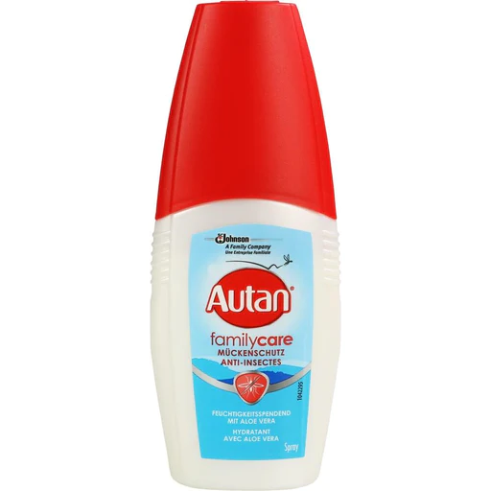
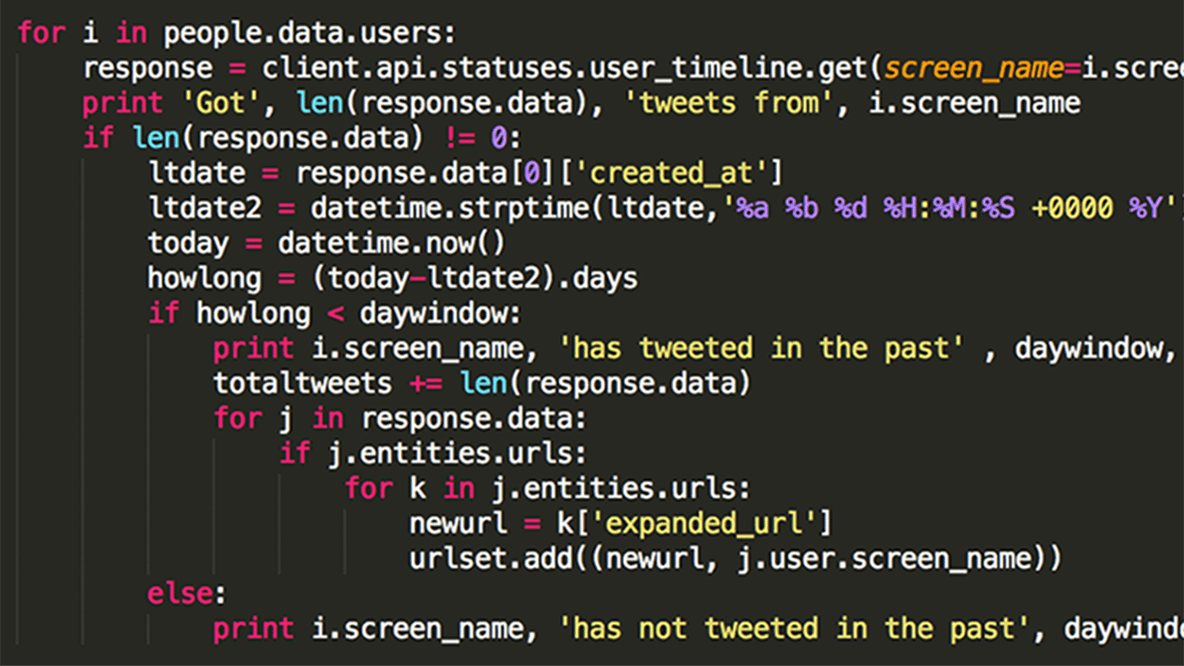
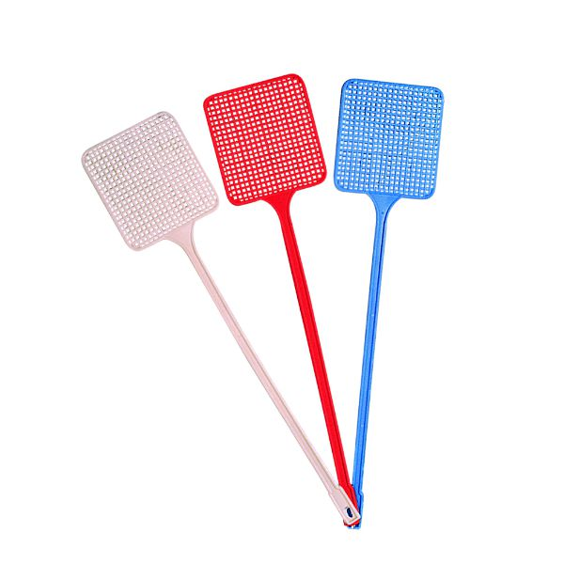
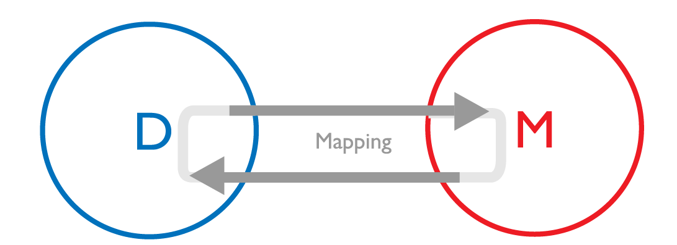
Scope of Presentation
Real Problem
Mathematical World

Slide 5
Mosquito Borne Diseases
Climate Change, globalisation and other drivers are altering ecological conditions for mosquitoes.
Mosquito-Borne Diseases (MBDs) are present in over 100 countries.
700,000 deaths per year.
Malaria, most lethal for kids aged under five in the sub-Saharan regions.
Europe a “hot spot” of West Nile Virus (123 cases and 11 deaths in Greece this year so far).
Chikungunya and dengue fever increased 40% over 1950¹.

Slide 6
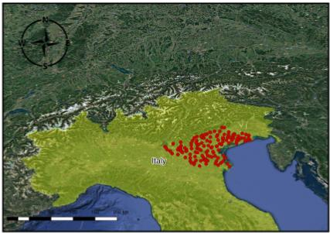
MAMOTH
MAMOTH - Mosquitoes Abundance prediction Model autO-calibrated from features pleTHora
Over 10 years of historical data, about mosquito abundance
Add OE information to build a data-set
Modeling and AI to predict

Slide 7
MAMOTH’s Vision
Data-driven approach relying on open widely accessible EO data
Automated Tuning:
No human bias on feature selection is injected on the model
Transferable and replicable
Accurate and reliable
Tree-based Solution
Literature and Feature Eng.
Initializer
Model & Hyper-Grid
Train Dataset
Final model
Feature
Expan.
Feature Selection
Init. Dataset
Expanded train Dataset
Model Validation
Validation Dataset
Tsantalidou et al. "MAMOTH: An Earth Observational Data-Driven Model for Mosquitoes Abundance Prediction"

Slide 8
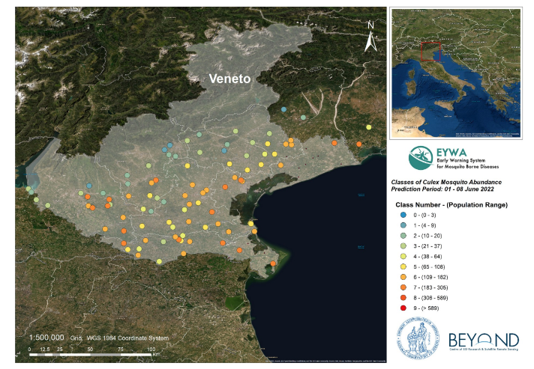
MAMOTH Predictions
Model Performance In Veneto (Italy)
MAE: 1.30
Error ≤ 3: 96%

Slide 9
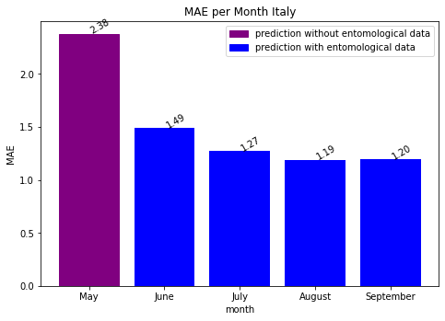
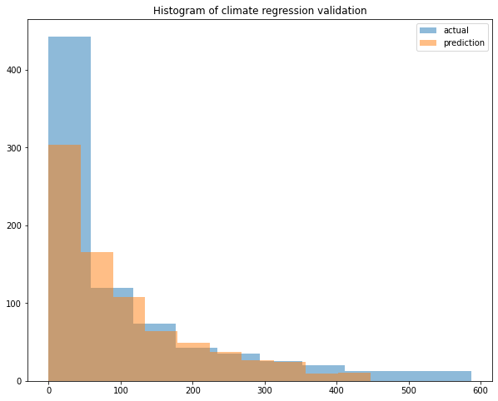
MAMOTH Predictions
Performance in a nutshell
Number of predictions: 603
Mean error: 1.38 (1.30 with, 2.38 without)
% of error ≤ 3: 94 %
MAE of prediction in May is higher due to the lack of recent entomological data

Slide 10
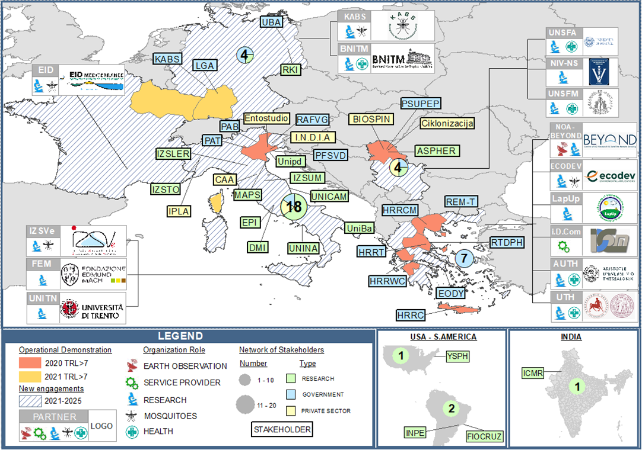
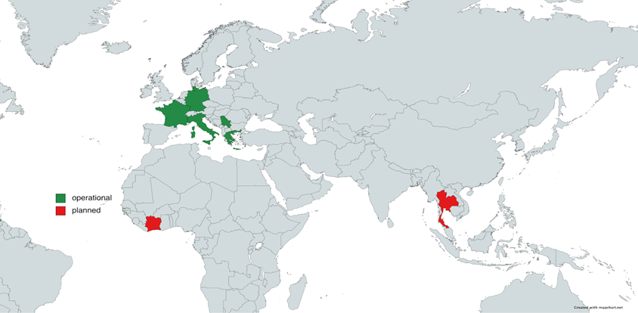
The Workload Increased!
At 2020 we delivered operational predictions for:
3 Countries, Italy, France, Germany
3 different mosquito species
After the success of EYWA the load increased!:
7 Countries, Italy, France, Germany, Serbia, Greece, Thailand, Côte d’Ivoire
12 Regions
3 different mosquito species
Monthly based
We can say that we weren’t totally prepared for that :)
A lot of developing and automation happened and a lot is still needed…

Slide 11
Wrapping up
The process got automated with or without entomological (still work to do)!
The core of the system improved in terms of speed X100, Data-Cube (lead by Lazaros and Kwstis)
Still no Break-Through in the Accuracy
Various algorithms, NN, Auto-encoders, Any trick,
Various different features…
Manipulating the cost functions
You can not learn more than the information that your data includes
Our hope, Gain from scale!
We Combined Climate Change forecast, for long term mosquito abundance prediction
Predictions Anywhere
Human Health, predicting the WNV

Slide 12
Long term Predictions Under the Impact of Climate Change
Lead by: Argyro Tsandalidou
Collaboration with: Prof. P. Zanis and his team from Department of Meteorology and Climatology, AUTH
Tsandalidou et al, “A Data Driven Approach for Analyzing the Effect of Climate Factors on Mosquitos Abundance and Estimate the Impact of Climate Change”, to be submitted in Springers Climatic Change Journal

Slide 13
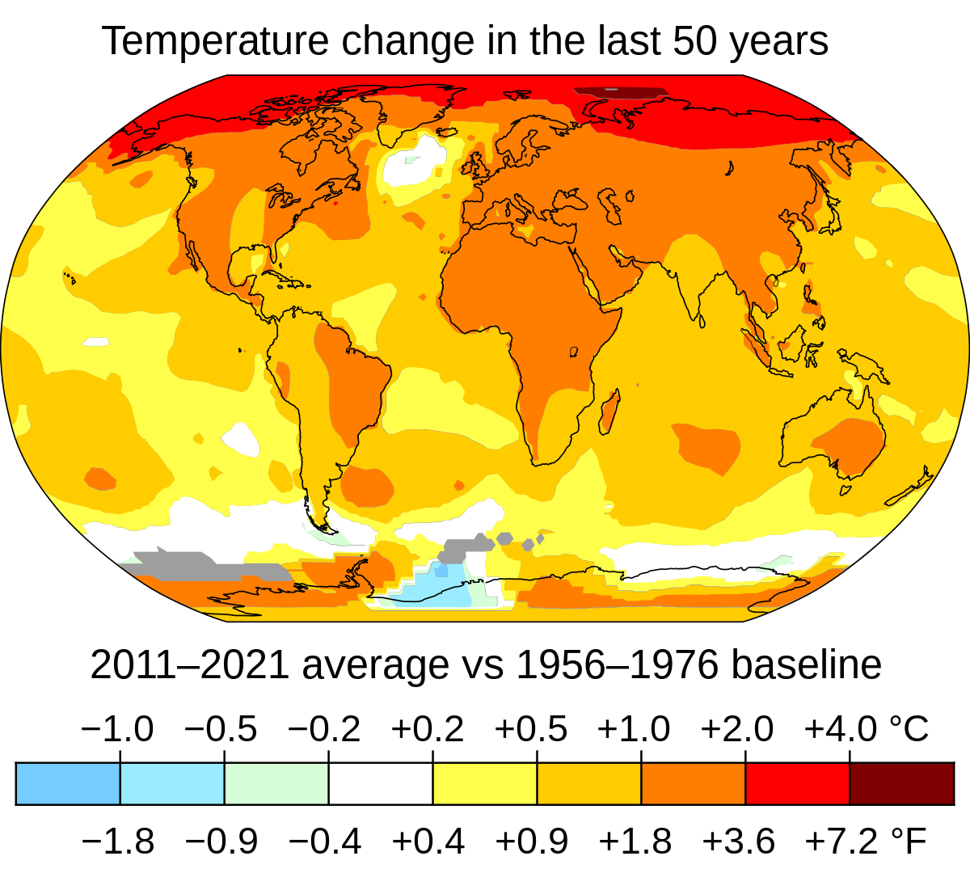
Climate Change is affecting the conditions
prevailing on an area, temperature and rainfall
being the primary affected factors.
In turn, temperature and rainfall affects the mosquito abundance and MBDs circulation
🔎
Question: How the climate change will affect mosquito abundance in the upcoming decades?

Slide 14
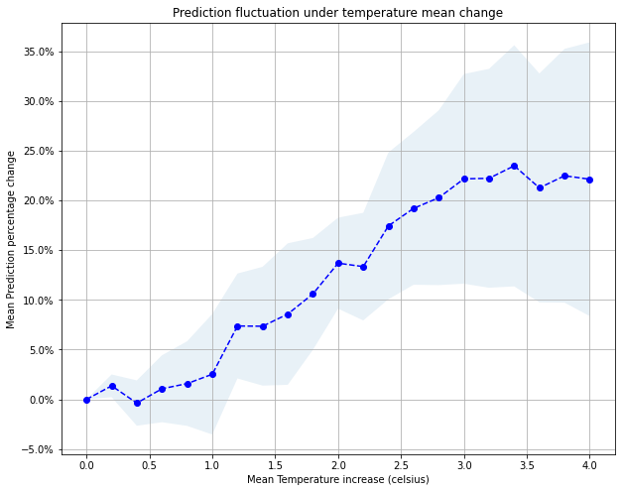
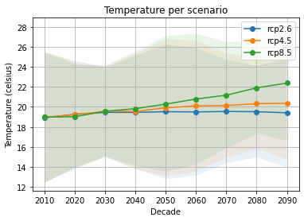
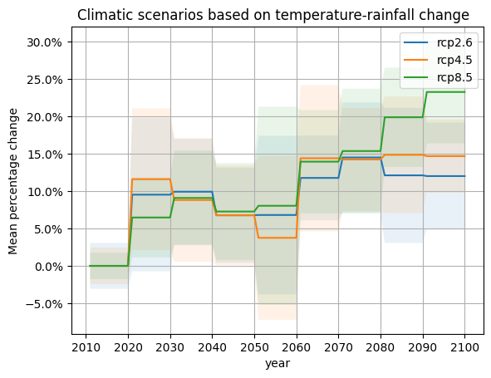
Our Approach
Performance Analysis
How temperature and rainfall
affects the MA
+
Climate Analysis
What the MA will be based on the climatic projections
Notes:
Methodology: Based on the MAMOTH framework, we train an unbiased Machine learning model that predicts the mosquito abundance. The ML model for the prediction relies only on the specific meteorological parameters that we want to study (Temperature, Rainfall, etc)

Slide 15
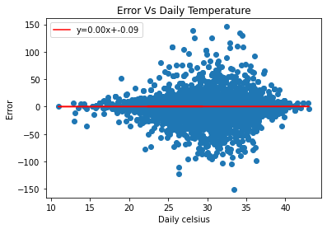
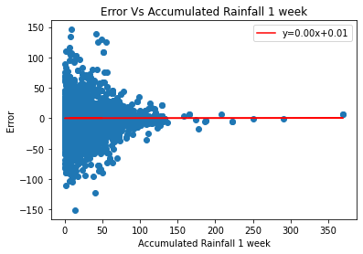
Performance analysis [1/4]
MAE on train set: 10.40
MAE on test set: 61.85
% of error < 20: 32%
The model should be trained with acceptable mean
error and no statistical bias.
The error is unbiased to temperature and rainfall as it is symmetrically distributed around zero. In other words, the model is not tempting to underestimates or overestimates the mosquitoes abundance if we increase or decrease the temperature (or the rainfall).
Fitted line on both plots has a coefficient of slope equal to zero, proving that the estimator is unbiased to those two features.
Once the model is trained on historical data, it predicts on data on which temperature and rainfall have been artificially changed (or others parameters of interest).

Slide 16
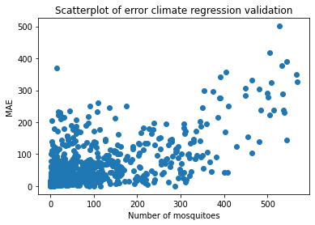
Performance analysis [2/4]

Slide 17
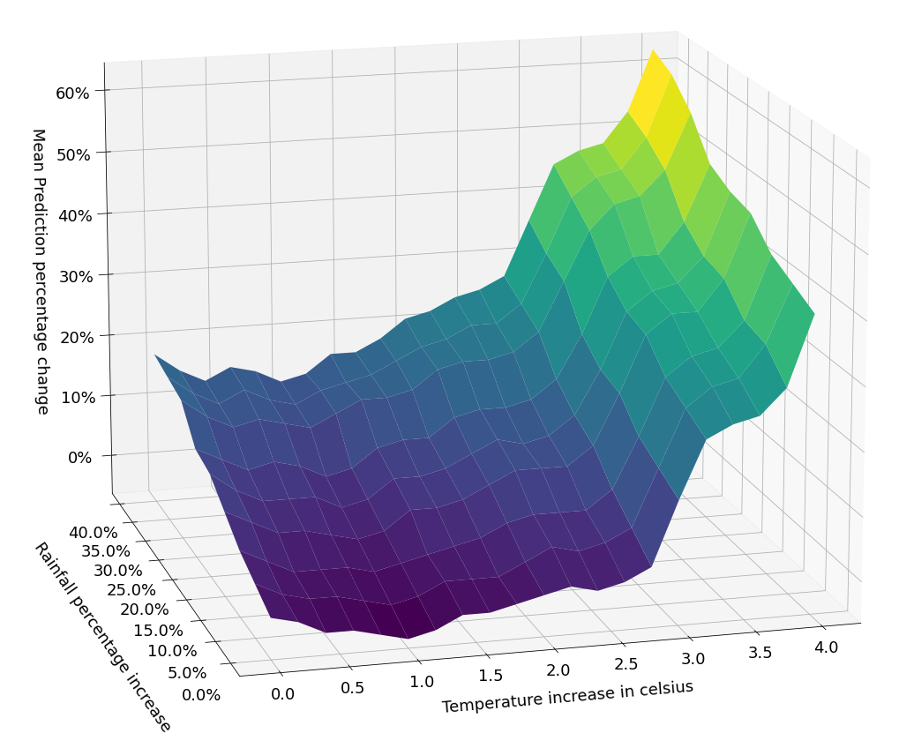
Performance analysis [3 / 4]
Mean value: add a constant value
↗ Mean ⇒ ↗ MA

Slide 18
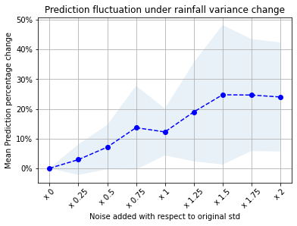
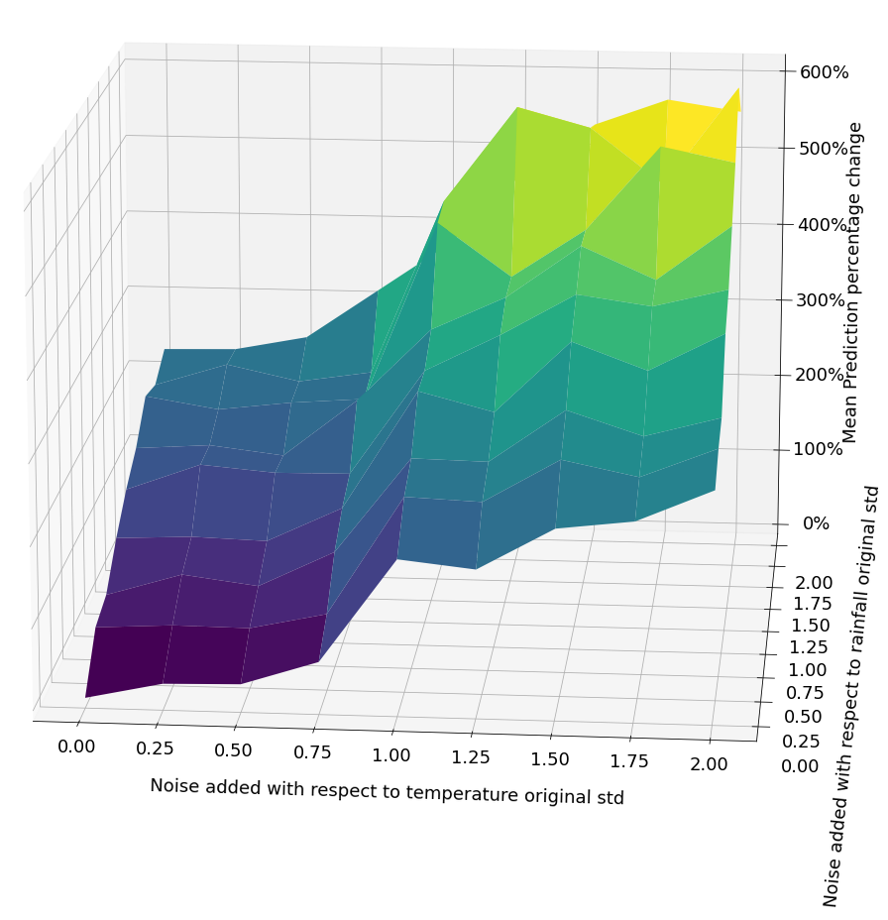
Performance analysis 4/4
Variance value : inject zero mean Gaussian Noise Ν(0,α·σ) on the data
↗ Variance ⇒ ↗ MA

Slide 19
Climate analysis
Future projections of MA per decade on temperature and rainfall based on the 3 climatic scenarios:
rcp2.6: ↘ of CO₂ (optimistic)
rcp4.5: ≃ of CO₂ (mediocre)
rcp8.5: ↗ of CO₂ (pessimistic)

Slide 20
Conclusions
We test our methodology to 3 cases of interest, Greece, Italy,Germany
Performance Analysis showed that:
Increase on mean and variance is directly linked to MA increase
Variance increase has bigger impact on the MA than mean increase
Climate Analysis revealed that:
Prediction based on rcp2.6 and rcp4.5 scenarios are ranging in the same levels, while rcp8.5 leads to bigger increase on MA
Germany will face the bigger increase of mosquitoes in the long term

Slide 21
Predicting Mosquito Abundance Anywhere on Earth
Lead by: Theoktisti Makridou
Makridou et al, “A Study for Area-level Mosquito Abundance Prediction by Using Supervised Machine Learning Point-level Predictor”, International Conference on Mosquito Vectors and Epidemiology of West Nile Virus

Slide 22
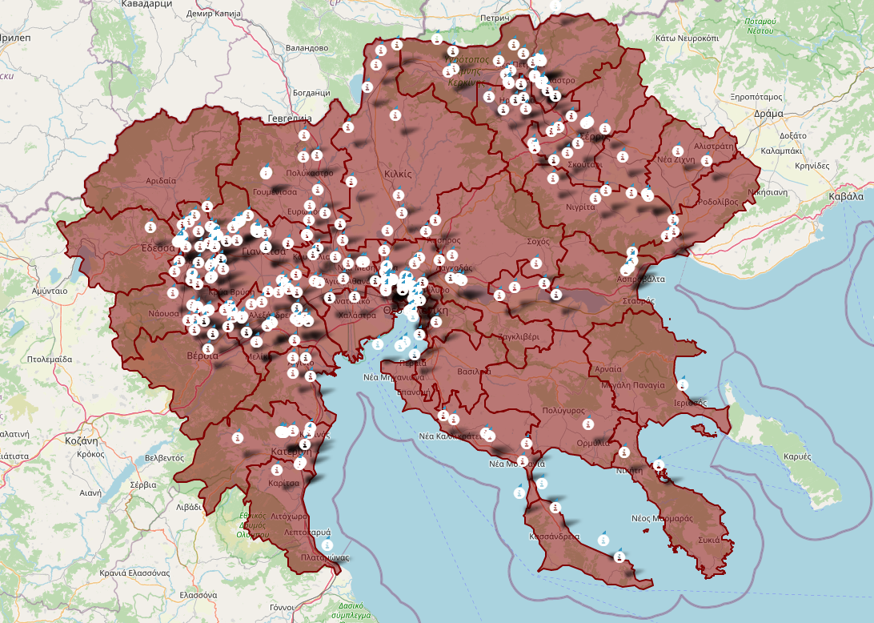
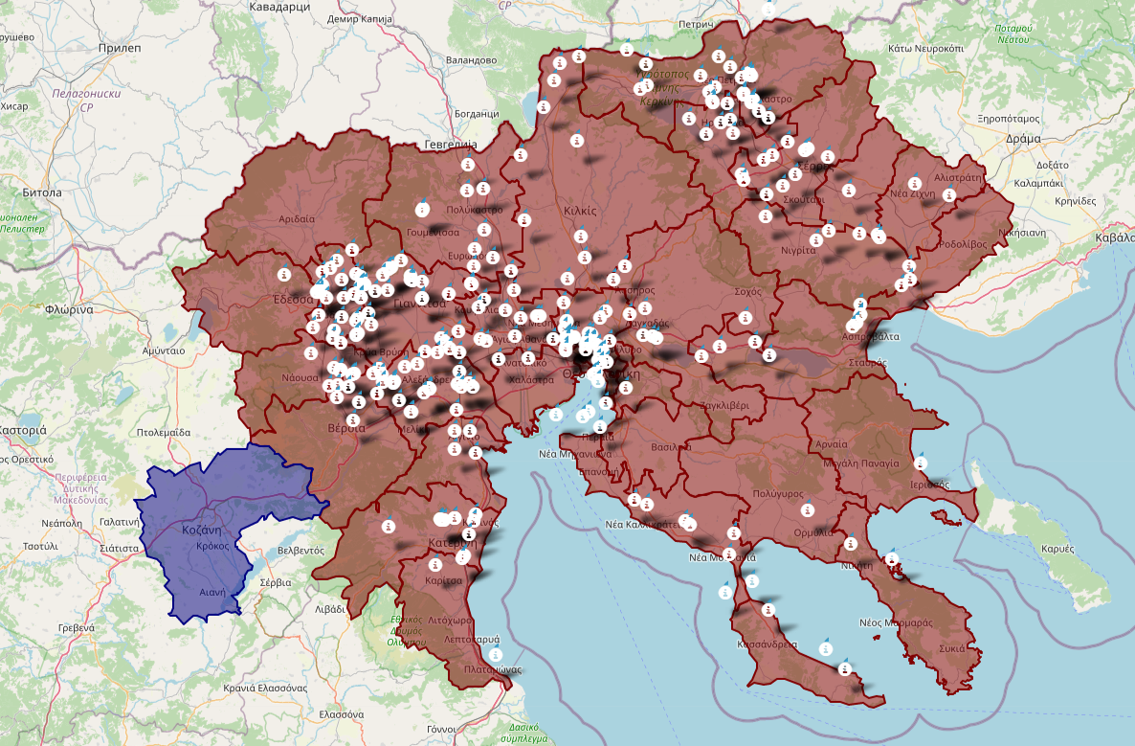
Predicting Anywhere
Out of trap predictions?
Information about an area not a point?
What if we would like to give predictions for a totally new area?

Slide 23
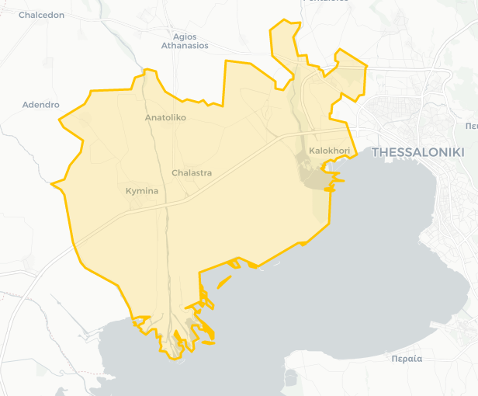
Methodology
Oversample the space with a given density λ
Delete the points closer than a given distance: similar to hard core point process
For the remain points obtain the OE, geomorphological, meteorological, information
Predict for each point, and after we merge the information to area level
For validation compare with the corresponding real measurements
We had to re-define what we mean fast 1 sec x 1M points ~ 12 days

Slide 24
Predictions Specific Area
Week 17
Week 22
Week 25
Week 18
Week 23
Week 26
Week 20
Week 24
Week 27

Slide 25
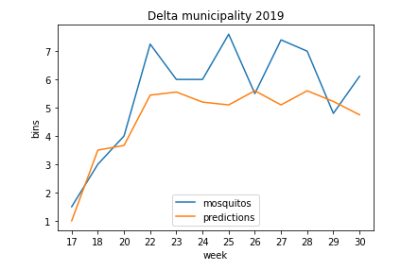
Validation

Slide 26
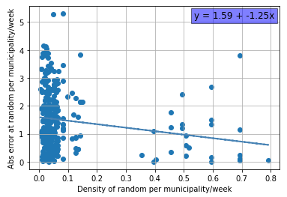
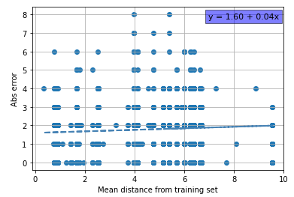
Performance Analysis
The performance increases, as we increase sampling density λ
The euclidian distance from the training samples is not highly correlated with the performance… ???

Slide 27
A bit of Transfer Learning
Delta Municipality | Abs error (2019-2020)
No Data for the area | 2.15
Extra train on 2018 Data | 1.83
Extra train on 2017-18 Data | 1.71

Slide 28
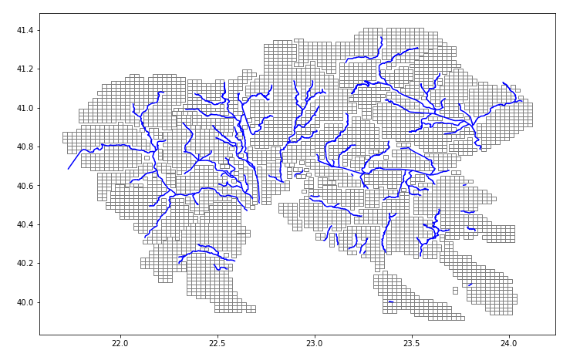
Sampling Wide Area

Slide 29
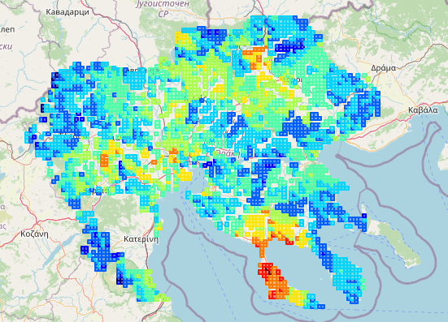
Taking a Complete Map
Density 2km
#3500 points

Slide 30
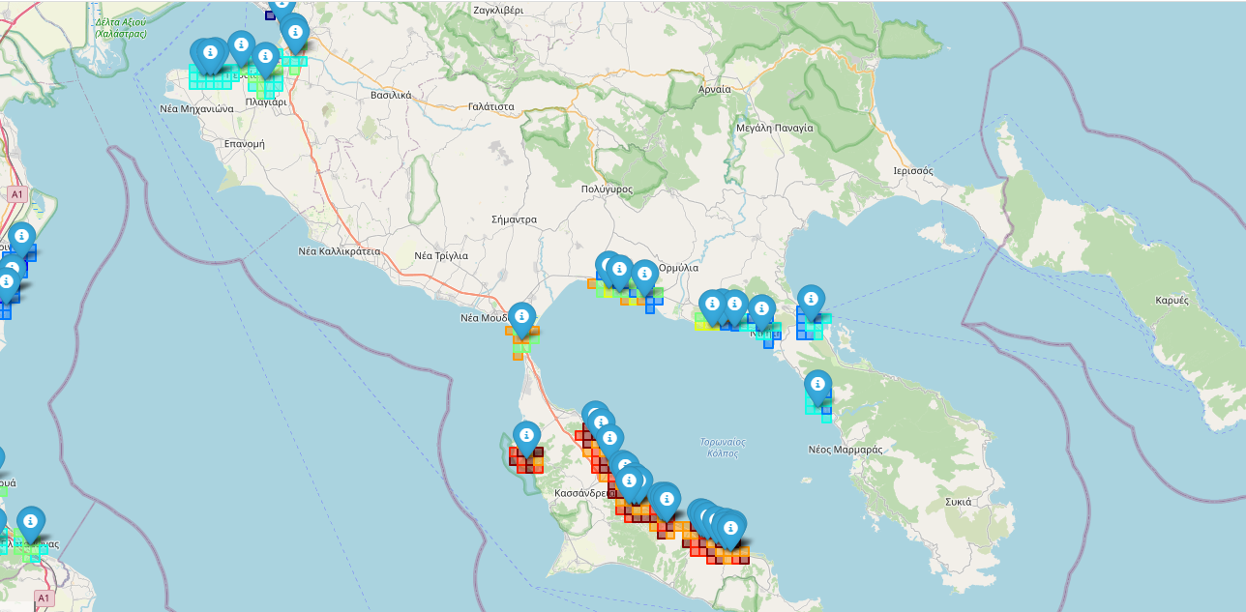
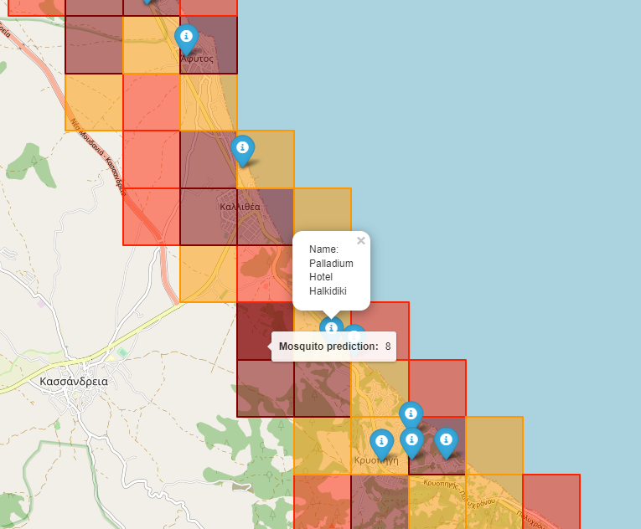
Smaller Granularity: Hotel’s Case
- Mosquito Abundance as proxy for the nuisance
- Density 1km
Around Hotels

Slide 31
Conclusions
Study the dependency from the distance from the initial train set
Further study the transfer learning capabilities
We are able to provide predictions, in off-trap points
We are able to provide predictions in any shape file, that a stakeholder finds useful
A new area can fast increase its performance using knowledge from similar areas
Now I learned how to provide useful information for a given area!

Slide 32
Predicting the Human Health Risk
(initial study)
Lead by: Dimitris Sainidis

Slide 33
Human Health - West Nile Virus Case
MBDs infect almost 700 million people / per year
~ 700.000 Deaths per year
In Greece
According to National Health Organization 123 cases of West Nile Virus have been recorded from the beginning of the 2022 period until August 30.
Of those 123 cases, 36 were diagnosed in the last week and so far 11 people have died

Slide 34
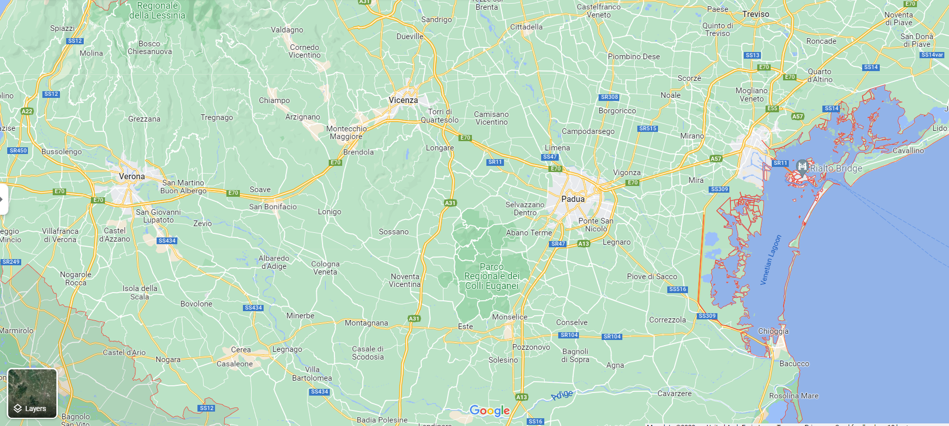
Human Health Risk
Historical health data of case appearances
88 municipalities
Predict, in a two weeks ahead
Goal: Predict which municipalities are in the most danger?

Slide 35
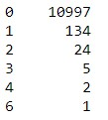
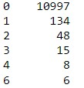
Data Preparation and Modeling
Divide timeline into two week period spans:
We model the problem as a binary classification (On-Off)
Augment all non-cases for each municipality
Add Geomorphological data
Obtaining Satellite data for the areas of interest
Averaged weather data within the defined period
Feature engineering / extraction
Categorical encoding
Scaling
Give weight to the observation of multi-cases
Sparse Dataset
Add Mosquito Abundance information for each area and date of interest
I learned how to do that!

Slide 36
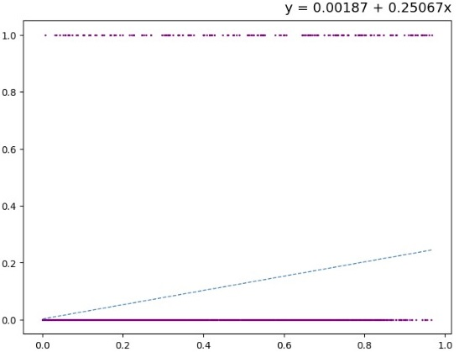
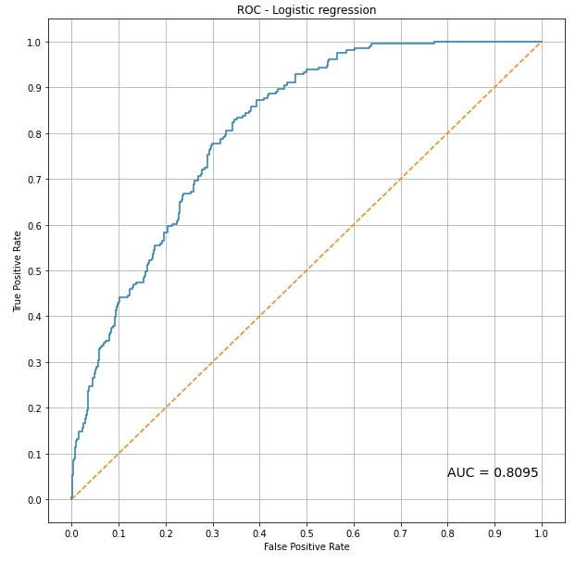
Model Training
To cross validate our binary classifier:
We leave one year out for validation and train on the rest
For every iteration we gather the output probability, the ground truth, the year and municipality.

Slide 37
Model Training
To cross validate our binary classifier:
We leave one year out for validation and train on the rest
For every iteration we gather the output probability, the ground truth, the year and municipality.
case recall | avg recall | balanced acc
0.9483 | 0.8036 | 0.6087
performance on train set
case recall | avg recall | balanced acc
0.4166 | 0.5509 | 0.2376
performance on test set

Slide 38
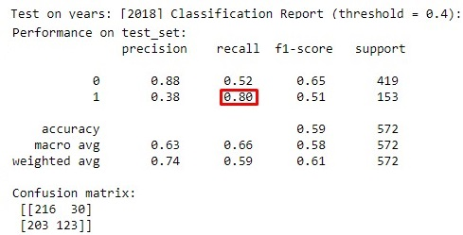
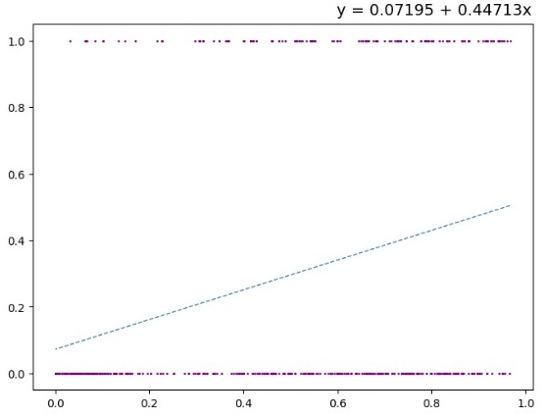
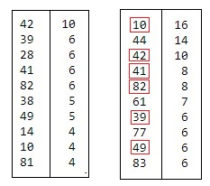
Operational Example
GT
Using 2018 as the test year:
Pred
Least squared fit between x (output probability) and y (ground truth). The slope determines the quality of the classifier (slope 1 is being the best)
Out of 10 most dangerous municipalities our model correctly found 6 ( random 1 )
Using 0.4 as classification threshold,
our model found 80% of all cases

Slide 39
Thank you!
We look forward for Collaborations
And students with good mathematical background that likes code :)

